Slide 1
Uscope: A scalable Unified tracer from kernel to user space
Junghwan Rhee, Hui Zhang, Nipun Arora,
Guofei Jiang, Kenji Yoshihira
NEC Laboratories America
www.nec-labs.com

Slide 2
Motivation
Errors
IT software faces diverse functional and non-functional issues due to complexity of software and usage of underlying components.
OS tracing is a convenient method to monitor and debug system operations without hard dependency on application layers (e.g., Libraries, program binaries).
Example: System call trace
However, OS events can be triggered by diverse programs and code. Therefore there is semantic gap to understand application program behavior from OS events.
Performance
Security

Slide 3
Unified Tracing
Trace logs across the boundary of kernel and space
i.e., user stack trace on OS kernel events
Examples: Dtrace, Windows ETW, System Tap
Two types of Unified Tracing
App B
App A
App B
App C
main
main
main
main
?
App
A
App
C
User Space
f_{B,P}
f_{A,1}
f_{B,1}
f_{C,1}
…
?
…
?
…
User
Probe
Library
Library
Library
Kernel
_{syscall}
Type 1 Unified Tracing
(User space to Kernel)
(b) Type 2 Unified Tracing
(Kernel to User space)
 | Trigger | Traced Target
Type 1 | User code | Trace the execution of known user code
Type 2 | Kernel code | Trace unknown user code triggering kernel code

Slide 4
Type 2 Unified Tracing
Type 2 unified tracers generate events on kernel events of interest.
A typically used technique to collect user space code information is stack walking.
Tracer finds the user process stack in the current context and scan stack frames from the stack pointer address.
Examples
Ustack of Dtrace, Stackwalking of Microsoft ETW
These solutions have been generally used for debugging scenarios. How we can lower overhead?
App A
App B
App C
main
main
main
?
f_{A,1}
f_{B,1}
f_{C,1}
…
?
…
?
…
Library
Library
Library
_{syscall}
Type 2 Unified Tracing
(Kernel to User space)

Slide 5
Challenges : Tracing Focus
Tracing all programs?
There are numerous processes in typical desktop and server systems at runtime for various purposes (e.g., multitasking, administration, accounting, users’ daemons).
Unless the user has no idea on which programs went wrong, tracing all processes is not ideal.
Figure: A process hierarchy of an idle desktop machine

Slide 6
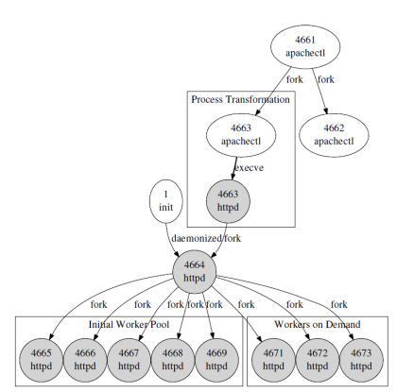
Challenges : Tracing Focus
Tracing an application software?
Programs create and kill many sub processes dynamically.
Some processes change their identity (execve system calls).
How to systematically track all processes from their start? (instead of giving PIDs to tracers)
Apache Controller forks a child
Child of the Apache Controller
becomes the Apache daemon.
Apache daemon forks children on demand.

Slide 7
Challenges : Tracing Focus
Tracing the whole stack?
Programs may have deep stacks. ECLIPSE project reported that the collected stack trace ranged from 1 ~ 1024 stack frames.
A stack includes function call information of multiple software layers (programs, libraries, middleware, and kernel etc.)
Not every stack layer may be in users’ interest.
LibC
Libraries
Program

Slide 8
Uscope: Systematic Unified Tracer
Flexible and configurable tracing scopes
Efficient per-application tracing
Systematic tracking of dynamic processes
A highly configurable focus within the call stack
LibC
Libraries
Program

Slide 9
Uscope Architecture
User
Space
App A
App B
App C
Process
1
Unified Trace
OS Kernel
App B
Flexible
Stack Walking
Per-App
Tracing
OS Kernel
Kernel Tracing
Target
User Tracing
Target
Tracing
Mode
Input:
Kernel Tracing Target : the kernel events that generate log events
User Tracing Target : the application software to be traced
Tracing Mode : specification on the call stack focus to be traced
Output:
Unified Trace for an application software

Slide 10
Per-Application Tracing Logic
Kernel
Event
Is it a Kernel
Tracing Target?
Get the current PID
1
2
Trace
Map
3
Dynamic
Process
Management
Layer
5
PID
Name
PTR
Add a new process
Remove a process
Invalidate CRLT
…
101
A
PTR
exit
execve
A
PTR
fork
Obtain CRLT via PTR
Flexible Stack Walking
102
103
B
OUT
6
A
PTR
execve
104
Null
104
? (New)
Set up CRLT/PTR
Return
4
8
…
7
This diagram shows the logic how Uscope performs per-application tracing and systematic tracking of dynamic processes.
Trace map maintains the sets of processes (1) unknown, (2) to trace, and (3) not to trace.
Kernel events making dynamic changes of processes (e.g., fork, exit, execve) trigger corresponding changes on the trace map.

Slide 11
Flexible Call Stack Scope
Call stack
during
a Syscall
Mode 1
(App)
Mode 2
(App All)
Mode 3
(Library)
Mode 4
(All)
Unrecorded call site
C_{1,1}
C_{1,1}
C_{1,1}
C_{1,1}
C_{1,1}
C_{1,2}
C_{1,2}
C_{1,2}
C_{1,2}
C_{1,2}
…
…
…
…
…
Recorded call site
R₁
C_{1,n1}
C_{1,n1}
C_{1,n1}
C_{1,n1}
C_{1,n1}
…
…
…
…
…
Stack walking
C_{k,1}
C_{k,1}
C_{k,1}
C_{k,1}
C_{k,1}
C_{k,2}
C_{k,2}
C_{k,2}
C_{k,2}
C_{k,2}
R_{K}
…
…
…
…
…
C_{k,nk}
C_{k,nk}
C_{k,nk}
C_{k,nk}
C_{k,nk}
Syscall
Recorded call sites during stack walking
Uscope provides flexible call stack scopes in tracing.
Maximum budge S. Further fine control is available.
 | Binary config | In-Binary config
Mode 1 | App binary | The last stack frame
Mode 2 | App binary | All stack frames
Mode 3 | All binaries, libraries | Last stack frames
Mode 4 | All binaries, libraries | All stack frames

Slide 12
Implementation
Tracer
Implemented by extending SystemTap.
SystemTap hooks system calls to generate log events.
Trace map and tracing logic is implemented as a kernel module.
Redhat Enterprise Linux 5 is supported.
Input:
Kernel Tracing Target : System call events
User Tracing Target : Apache webserver (Server workload), MySQL database (Server workload), Nbench (computation)
Uscope can be dynamically attached and detached to the kernel at runtime. When it is detached, there is no overhead.

Slide 13
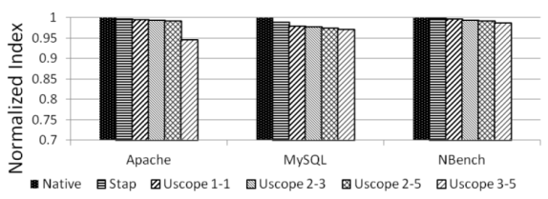
Runtime Overhead
Workload
Apache : Apache HTTP Benchmark tool (ab), 100 concurrency, 10^6 requests
MySQL : MySQL Benchmark suite (alter-table, ATIS, big-tables, connect, create, insert, select, transactions, and wisconsin)
Nbench : Linux/Unix of BYTE’s Native Mode Benchmarks (verison 2.2.3). “Memory Index”, “Integer Index”, and “FP Index” are used.
Tracing Modes :
Mode 1 : application call stack layer, the last stack frame
Mode 2 : application call stack layer, 3 or 5 last stack frames
Mode 3 : all layers, the last stack frames up to 5
Less than 6% overhead in three benchmarking cases

Slide 14
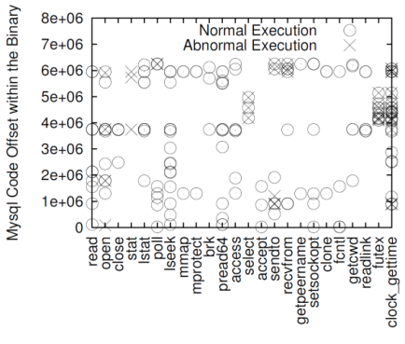
Case Study Application 1
Testbed
Three tier PetStore system (Apache, Jboss, MySQL)
Symptom
Web requests failed.
Tracing: Mode 2 (S=3)
Dual Space Analysis
X axis shows different types of system calls and Y axis shows application code (i.e., triggers).
Unique events in normal case
Read: my_read
Accept: handle_connections_socket
More..
Unique events in abnormal case
Stat: archive_discover
=> Problem in accessing the database file

Slide 15
Case Study Application 2
Testbed
Apache Webserver
Symptom
Concurrency error that threads are in a deadlock condition (Case number: Apache #42031)
Tracing: Mode 2 (S=5)
Call Stack Analysis
Call stacks on futex system calls are captured and analyzed.
Worker Thread
apr_thread_mutex_call (a wrapper of pthread_mutex_call)
Listener Thread
apr_thread_cond_wait (a wrapper of pthread_cond_wait)
=> Deadlock conditions are identified.
Workers
Listener
. . .
futex
deadlock
. . .
futex
Sys Calls
?
?
Program
deadlock
LOCK (timeout)
. . .
UNLOCK(timeout)
. . .
LOCK (idlers)
. . .
SIGNAL (waits)
. . .
UNLOCK(idlers)
. . .
LOCK (timeout)
. . .
LOCK (idlers)
. . .
COND_WAIT
(waits, idlers)
. . .
UNLOCK (idlers)
. . .
UNLOCK(timeout)
User code context

Slide 16
Limitations
System-Call-Driven
There are computation intensive applications functions that do not cause system calls.
Coverage can be extended by triggering stack walking in context switch.
Native vs. Non-native Programs
Uscope works on native programs written in C/C++.
Non-native programs such as Java and interpreter languages can be supported by integrating stack parsing logics. For example, jdb and jstack support stack walking of java stack and native stack.

Slide 17
Conclusion
Uscope provides efficient type 2 unified tracing for kernel and unknown user code.
Uscope provides per-application tracing, systematic tracing of dynamic processes, and flexible specification on call stack scopes to be traced.
Our prototype has 6% overhead compared to native execution in several benchmarks.
Also we showed two case studies how unified tracers can be used for debugging.

Slide 18
Thank you

