Slide 1



CLUE: System Trace Analytics for
Cloud Service Performance Diagnosis
Hui Zhang¹, Junghwan Rhee¹, Nipun Arora¹,
Sahan Gamage², Guofei Jiang¹,
Kenji Yoshihira¹, Dongyan Xu³
¹
²
³
www.nec-labs.com

Slide 2

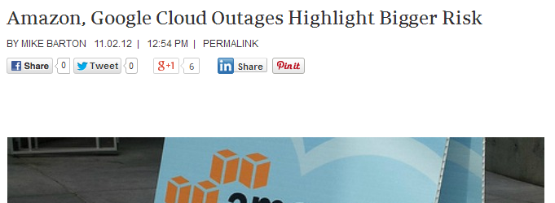
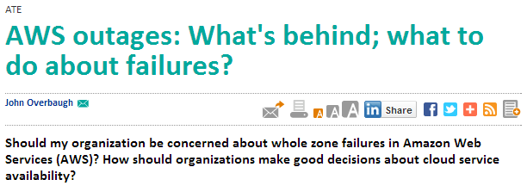
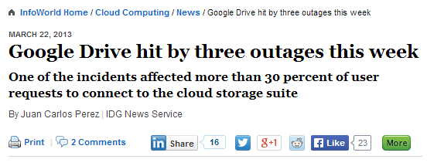
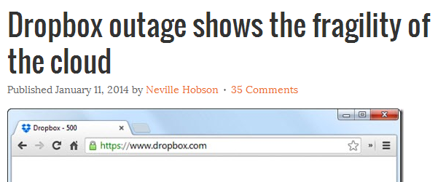



Cloud Service Performance Diagnosis
Era of Cloud Computing
  Many vendors are providing Cloud Services.
Cloud
computing
Our focus: How to diagnose performance problems of cloud service systems?

Slide 3
Background: Kernel Event-driven
System Monitoring
Kernel events represent an application’s interaction with the host system.
  Well-defined
  Independent of applications.
Application performance anomaly may be associated with unusual kernel events.
Localizing unusual events and making them comprehensible is an important step for performance diagnosis of cloud systems.
Cloud Platform
Application
Libraries
Kernel
Traces
Notes:
3
Research theme

Slide 4
Research Challenges
Massive traces in distributed systems
  Thousands of processes, millions of kernel events in minute periods.
Limited application information
  Common event types for all processes.
  Limited information for differentiating application behaviors
Tradeoff between run-time tracing overhead and diagnosis capability
Demand for a fast analytic tool for performance diagnosis using massive trace events

Slide 5
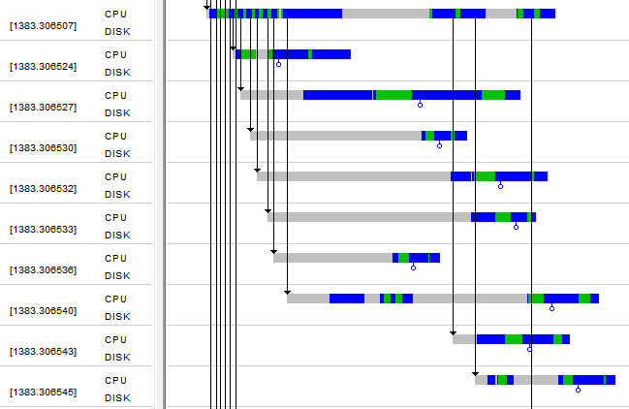
Motivation Example
Performance problem in an Internet gateway transaction application.
  Unexpected low transaction throughput in the deployment on a HP-UX high-end server with 16 cores.
Manual Problem Diagnosis
  Found nondeterministic scheduling delays.
  Huge manual efforts to find the symptoms
Research question
  How to describe and locate such symptoms in massive OS kernel events?
Many processes are forked from a common parent
Children show idle time without execution.
Visualized process activities

Slide 6
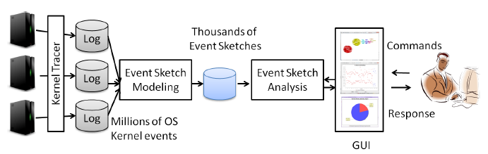
Overview of CLUE
CLUE is a trace analytic tool for Cloud service performance diagnosis using OS kernel event traces.
  Event sketch modeling on massive kernel event traces.
  Mining and performance analysis based on event sketches.
Tracing
Analytics

Slide 7
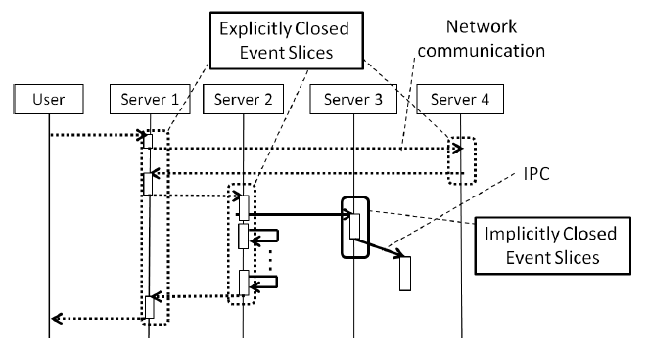
Service Model
Explicit and implicit closed event slices are used to understand the behaviors of multi-stage services.
Event Sketch Modeling
  Extract event sketches, groups of kernel event sequences having causality relationship.
  Explicitly closed event slices
    Event sequence formed on the basis of request-reply communication patterns.
  Implicitly closed event slices
    Event sequence formed on the basis of general producer/consumer communication patterns such as IPCs.

Slide 8
Event Sketch Modeling
Event Slicing
Event Slice Stitching
Event Sketches
httpd
java
mysql
httpd
java
mysql
Traces
Markers
Causality
Relationship

Slide 9
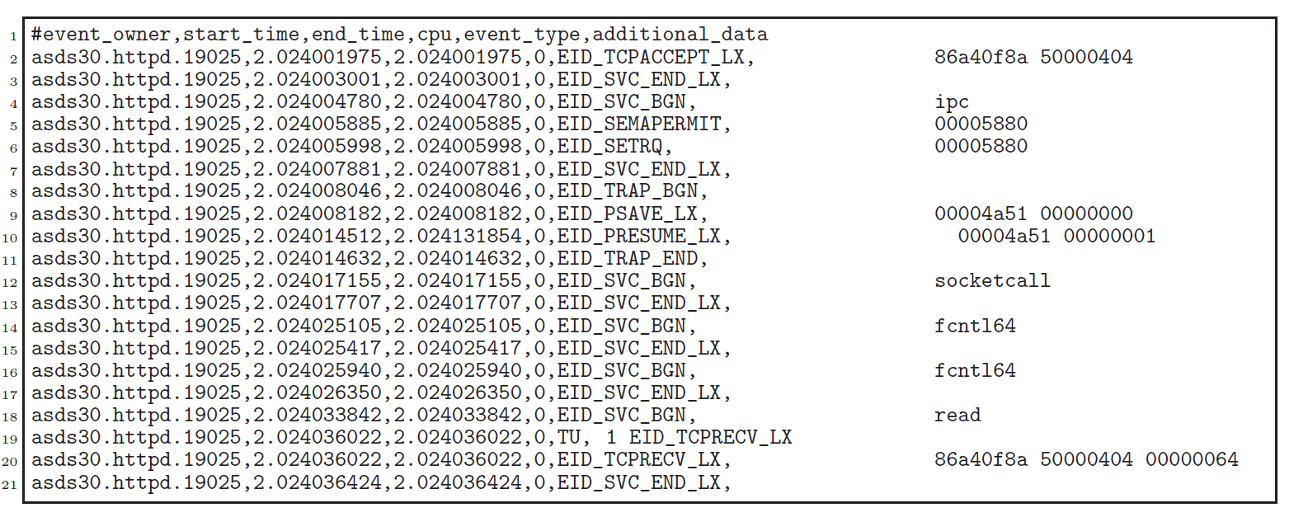
Kernel Event Record Definition
A kernel event is a 6-tuple record:
  Owner ID: the ID of the event owner (e.g., a process X in host Y).
  Time begin: the time when this kernel event starts.
  Time end: the time when this kernel event ends.
  CPU ID: the ID of the CPU processor/core where this event occurs.
  Event type: the kernel event type.
  Event data: the extra information associated with kernel event types (e.g., parameters).
Trace example: Apache httpd server
Owner ID
Time end
Event type
Event data
Time begin
CPU ID

Slide 10
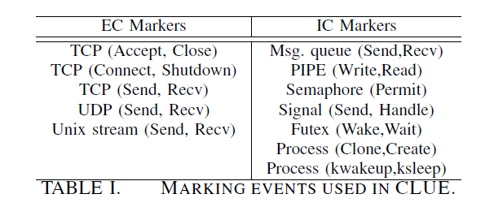
Marking Event Definition
A event slice mark is a 4-tuple record :
  Begin event type: the event type that the first event of an event slice must exactly match.
  End event type: the event type that the last event of an event slice must exactly match.
  Owner filter: the owner ID that the first and last events of an event slice must (partially or exactly) match.
  Event data filter: the event data that the first and last events of an event slice must (partially or exactly) match.
  Explicitly closed event slices markers
  Implicitly closed event slices markers

Slide 11
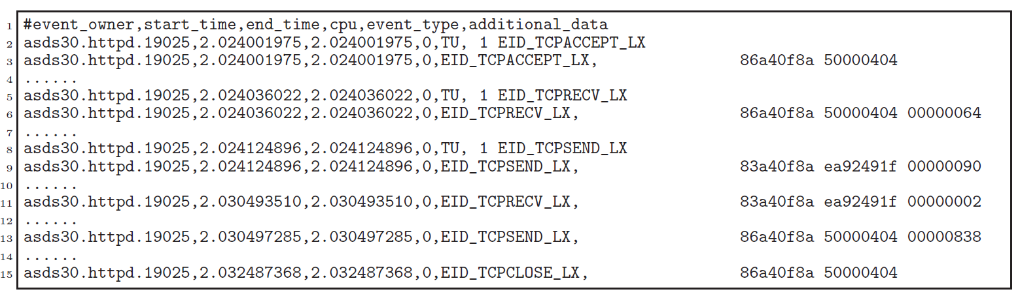
An Event Slice of Apache
In the event sequence of an apache webserver, one event slice is detected.
User’s web request
Send the reply back
Close the connection

Slide 12
Causality Relationship Definition
One causality relationship is presented as a 5-tuple record:
  Causing event type: a type of events that can cause the occurrence of other events.
  Caused event type: a type of events that are caused by other events.
  Time rule: the rule that a causing event type event and a caused event type event can be associated based on their temporal relationships.
  Owner rule: this defines the rule that a causing event type event and a caused event type event can be associated based on their owner IDs.
  Event data rule: this defines the rule that a causing event type event and a caused event type event can be associated based on their event data.
Causing
Caused
Send
…
Receive
Receive
…
Send
Event Slice
of
Webserver
Event Slice
of
Application
Server
Match of src and dest ports?
Notes:
Examples include but not limited to overlap temporal relationship, nested temporal relationship, and disjoint temporal relationship.

Slide 13
Event Sketch Analysis
Event
Sketches
Kernel
Feature
Generation
Clustering,
Conditional Data mining
Analysis
Result
Kernel Event Feature Generation
  Event sketches still have numerous events. It is costly to analyze event sketches in each event level.
  We extract concise properties of event sketches showing the characteristics of events for data analysis
  (More details in the poster this afternoon)
Clustering and Conditional Data Mining
  Unsupervised learning to correlate similar event sketches
  Narrow down the focus of analysis by applying analysis conditions

Slide 14
Kernel Event Features
We use two kernel event features to infer the characteristics of event sketches in a black box way.
Program Behavior Feature (PBF)
  PBF is a system call distribution vector.
  PBF is used to infer application logics behind the kernel events.
System Resource Feature (SRF)
  SRF is a vector of resource descriptions of system calls.
  e.g., connect : network, stat : file
1 brk
1 1
2 socket
2 2
Time, event, info
33324, syscall, brk
35323, syscall, write
35634, syscall, socket
42345, interrupt
51234, context switch
88234, syscall, read
92345, syscall, socket
3 send
3 0
… …
… …
System call
categorization
Program Behavior Features
1 Latency
1 32451
2 Network
2 2342
Event slice
3 File
3 35
… …
… …
Resource
categorization
System Resource
Feature

Slide 15
Conditional Data Mining
For black box trace analysis, it is important to narrow down the focus of analysis to a relevant set of event sketches to determine anomaly.
Essentially this is an iterative filtering process with successive applications of filter conditions. We model it as a conditional probability.
  P(C₂|C₁) where C₁, C₂ are conditions.
Examples of conditions: performance, application context, etc.
  A cluster based on program behavior features
  Event sketch marker type (e.g., Marker = TCP_ACCEPT)
  Latency, idle time (e.g., Latency > mean value)
  Process name (e.g., Process name = httpd.exe)

Slide 16
Case Study : Inefficient Gateway Service
Symptom
  Internet gateway transaction application in HP-UX server with 16 CPU cores
  Low transaction throughput
Blackbox analysis
  Direct access to the real machine or software is not available.
  Got the traces recorded by owners
Trace Analysis
  89568 kernel events, 82 event sketches
  78 sketches (over 95%) are constructed using implicitly closed event slices.
    Markers: kwakeup and ksleep system calls used for synchronization in HP-UX operating system.
  Clustering based on PBF (system call patterns) produced 7 clusters

Slide 17
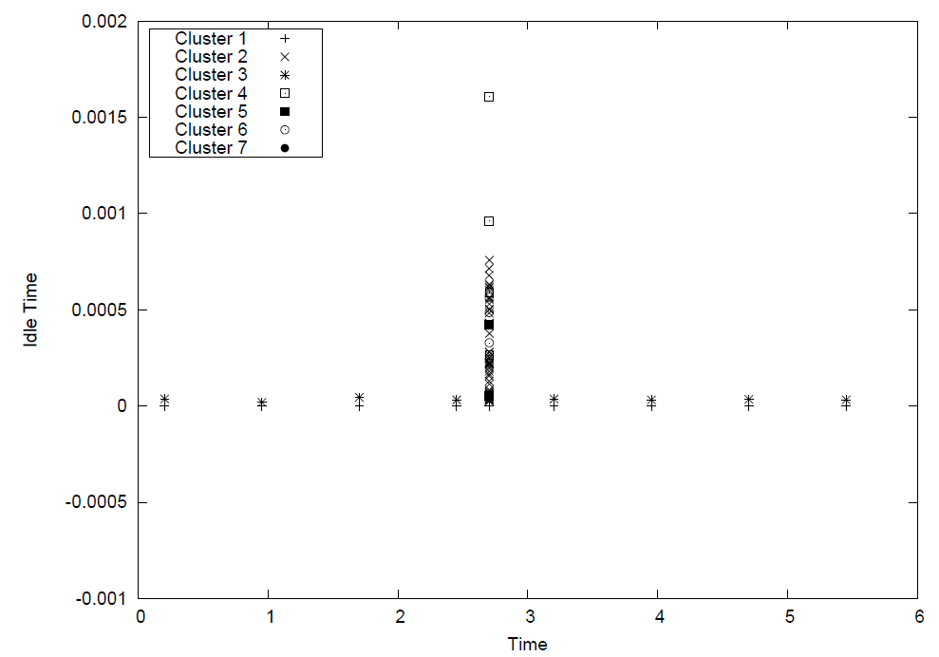
Clustering based on System Call Patterns
Different clusters show distinct behavior in idle time and time stamp.
  Application logics behind the kernel events are captured using system call patterns.
7 Clusters are illustrated.
  X axis: Time, Y axis: Idle time
  2 clusters have idleness below the mean and are spread over 0~6 seconds.
  5 clusters have higher idleness than the average and their events occurred around 2.7 seconds.
Idle time
Mean of idle time
Time stamp

Slide 18
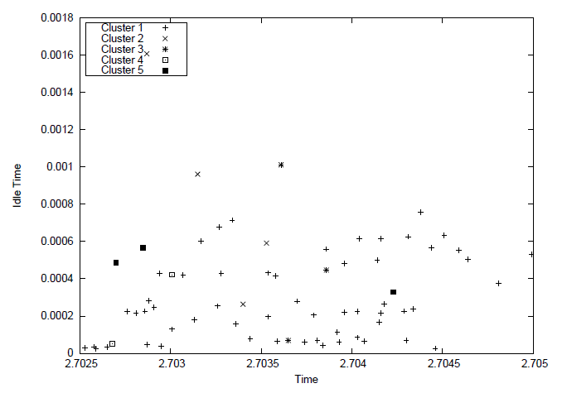
Conditional Probability
Clusters are further ranked with mean and variance of idle time.
Top clusters localize the problematic symptoms with high idleness in execution.
Manual inspection confirmed correct detection of anomaly patterns in the traces.
1) Conditional
Probability :
P(PBF)
2) Conditional
Probability :
P(PBF| )

Slide 19
Conclusion
We present a black-box (requiring no source code) method to monitor Cloud service environments and analyze performance problems.
We have expanded the trace modeling of previous approaches by introducing inexplicitly closed event slices.
We applied unsupervised learning with statistical analysis on the structured data to localize performance problems.

Slide 20
Thank you
www.nec-labs.com

